Slide 1
Dino Game
By: Samantha Jones and Sigourney Wamback

Slide 2
Table of contents
Plot
Game demo
What we worked on
Difficulties Encountered
What was easy
What we would’ve changed
Questions

Slide 3
Plot
The town borders have become overrun with bugs! Armed with your trusty fishbone gun you step up to stop the dangerous bugs. A secret lies waiting for you to find and use to defend the few townsfolk still remaining. Your goal is simple: kill the monsters until you’re overrun, use coins to access a second level and get messy.

Slide 4
Game Demo

Slide 5
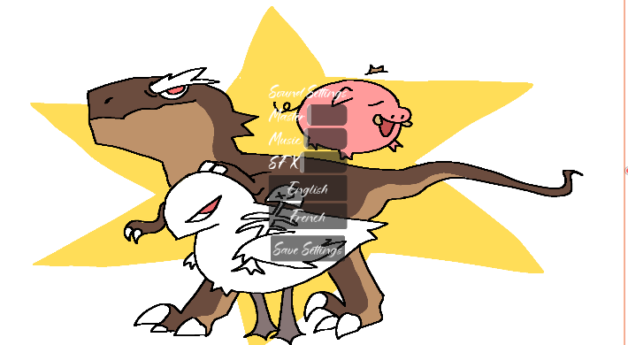

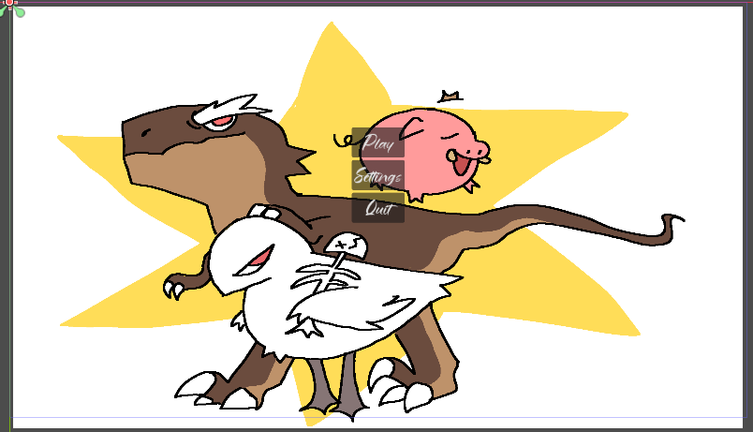
Samantha Jones
Main Menu
Settings Menu
Localization
Sound Assets
Some sprites
Code for the pickups
Coins
Pork
Code for coin counting

Slide 6
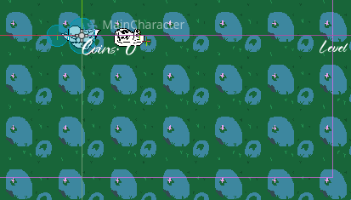
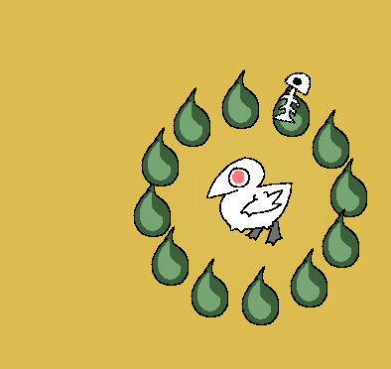
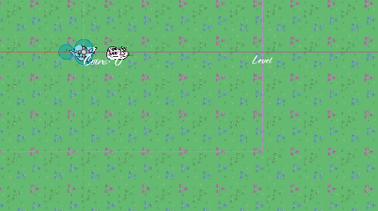
Sigourney Wamback
Enemies
Damage code
Assets
Health logic
Character coding
Weapons ( + weapon switching)
Dialogue
Level logic
Level scaling
Level + coin UI
“Skull” collectable
Win condition

Slide 7
Difficulties Encountered
Dialogue
Localization
Merge difficulties with Git

Slide 8
Parts that were easy
Assets
Coins
Character + enemy animations
Level logic
UI

Slide 9
What we would’ve changed
Added less global scripts ( we have about 5 or 6 when in reality we could’ve used just 1 or 2)
Researched the dialogue system a bit more

Slide 10
Questions?
Feel free to ask.

Slide 11
Credit for Sound Sssets
water scene – https://benjijam.itch.io/underwater-themes
coin sfx: Author: wobbleboxxSunday, November 16, 2014 - 08:49Art Type: Sound Effect
Credit for field of dreams Author: pauliuw Wednesday, December 8, 2010 - 05:37
Victory music: https://xdeviruchi.itch.io/16-bit-fantasy-adventure-music-pack

